Slide 1





ANALOG
and
DIGITAL
HACKATHONS
Under C2S Programme
Team FETManiacs
IIT GUWAHATI

Slide 2
Bandgap Current Reference (BGCR)
The objective of this design is to develop a bandgap current reference circuit that maintains a stable output current across a wide temperature range, from -40°C to 125°C, with low power consumption and excellent load regulation.

Slide 3
Specifications
Output Current : 100 µA +- 5% across the temperature range of -40°C to 125°C.
Technology : 90nm CMOS process
Power Supply : 1.8V to 3.3V
Power Consumption: Less than 50 µW for the entire current reference circuit. Temperature Coefficient : Less than 50 ppm/°C for the output current.
Load Regulation : Output current should remain stable within 2% when the load voltage varies from 0 to 1V.
Design Considerations:
Use a bandgap voltage reference to set the bias current.
Design a current mirror to generate the output current.
Consider process variations, transistor matching, and temperature stability in the 90nm process.

Slide 4
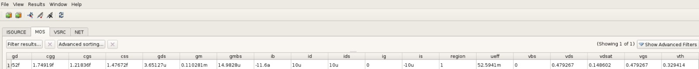
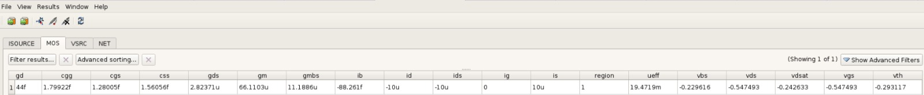
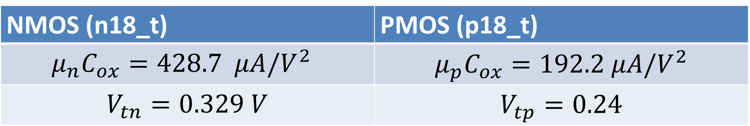
Device Characterization
NMOS (n18_t) | PMOS (p18_t)
$$μ_{n}C_{ox}=428.7 μA/V^{2}$$ | $$μ_{p}C_{ox}=192.2 μA/V^{2}$$
$$V_{tn}=0.329 V$$ | $$V_{tp}=0.24$$
NMOS
PMOS

Slide 5
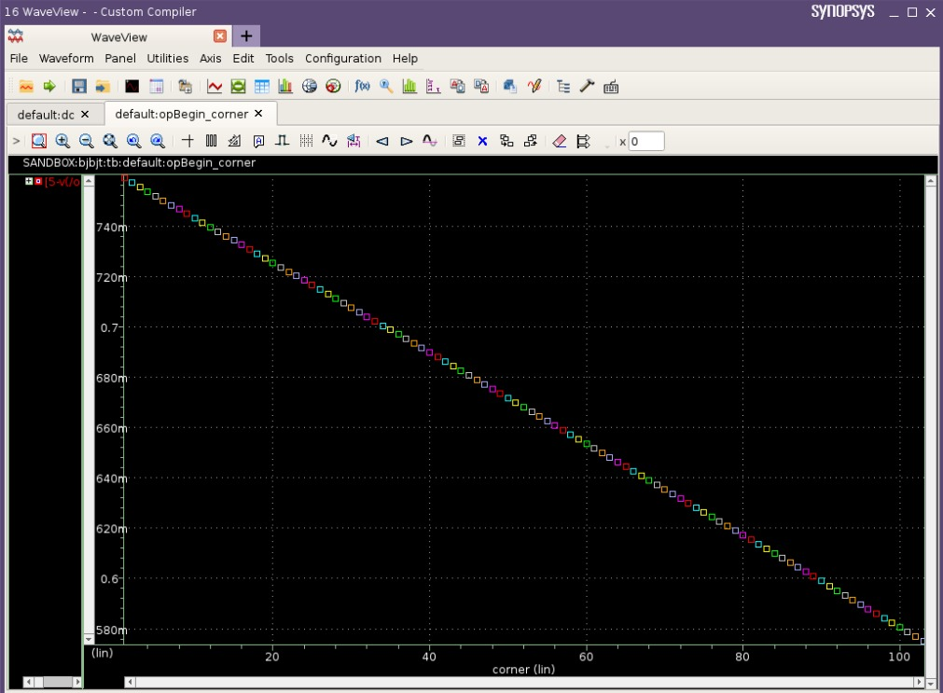
Temperature coefficient of $V_{be} of$VPNP = $1.8 mV/K$

Slide 6
Design
The design employs a Bandgap Voltage Reference that is converted into a current reference by adding appropriate resistors to add a CTAT current to a PTAT current and mirroring the temperature independent current using a cascode current mirror to improve load regulation.

Slide 7
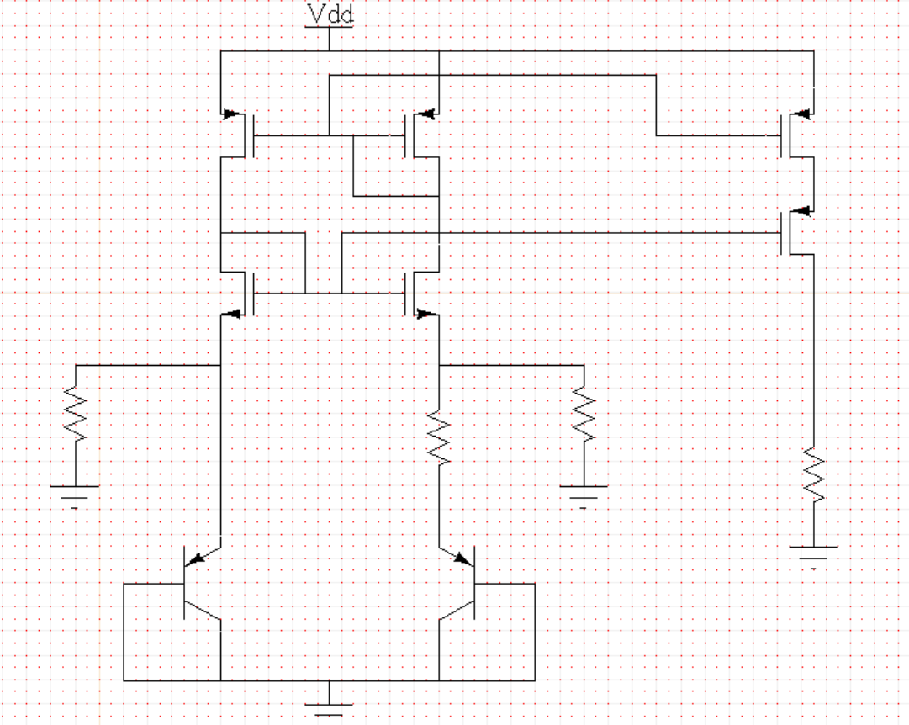
Design Schematic

Slide 8
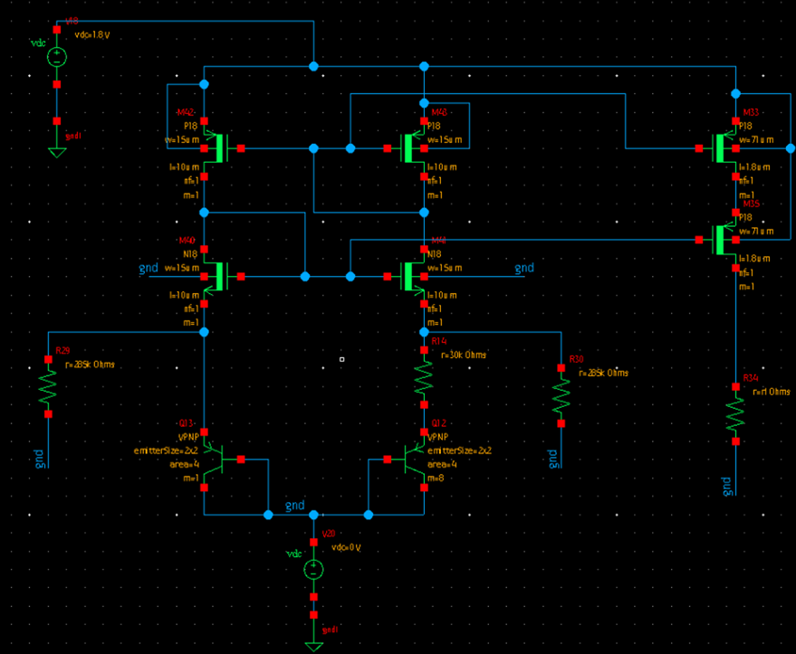
Design Schematic

Slide 9

Design Flow

Slide 10
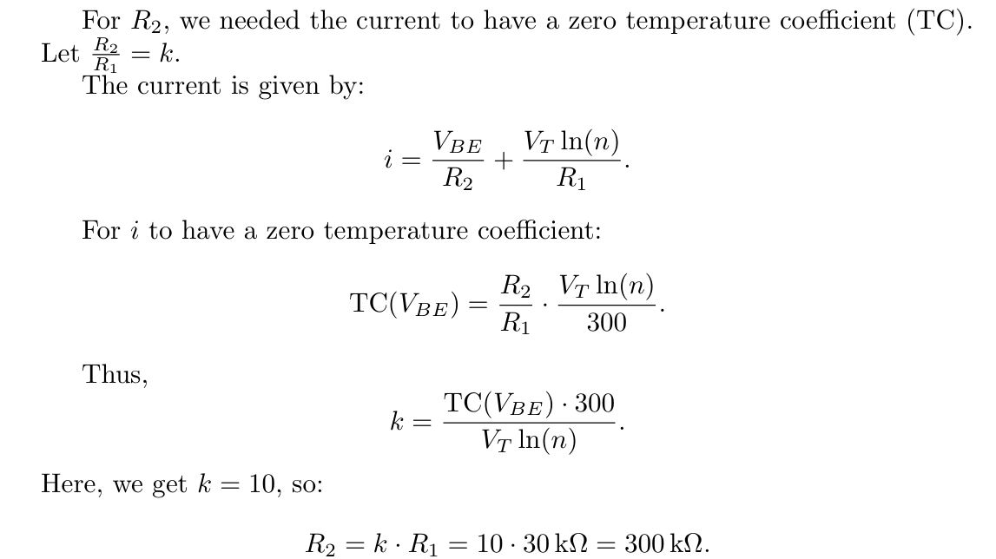

Slide 11
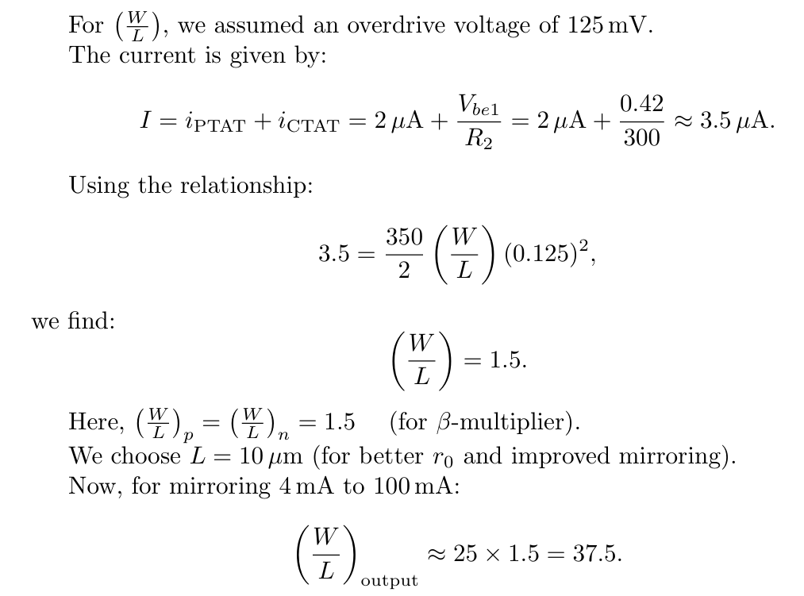

Slide 12
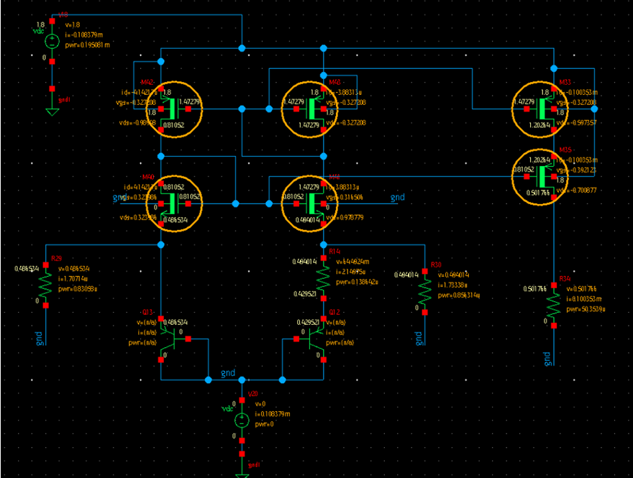
DC Operating Point

Slide 13
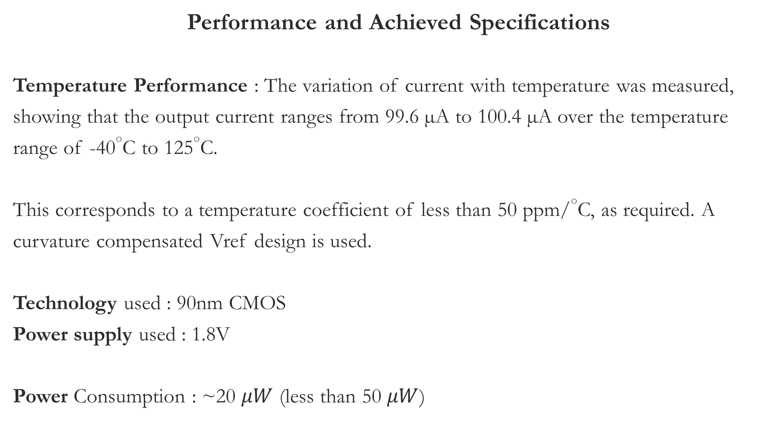
Performance and Achieved Specifications
Temperature Performance : The variation of current with temperature was measured, showing that the output current ranges from 99.6 µA to 100.4 µA over the temperature range of -40°C to 125°C.
This corresponds to a temperature coefficient of less than 50 ppm/°C, as required. A curvature compensated Vref design is used.
Technology used : 90nm CMOS
Power supply used : 1.8V
Power Consumption : ~20 $μW$ (less than 50 $μW$)

Slide 14
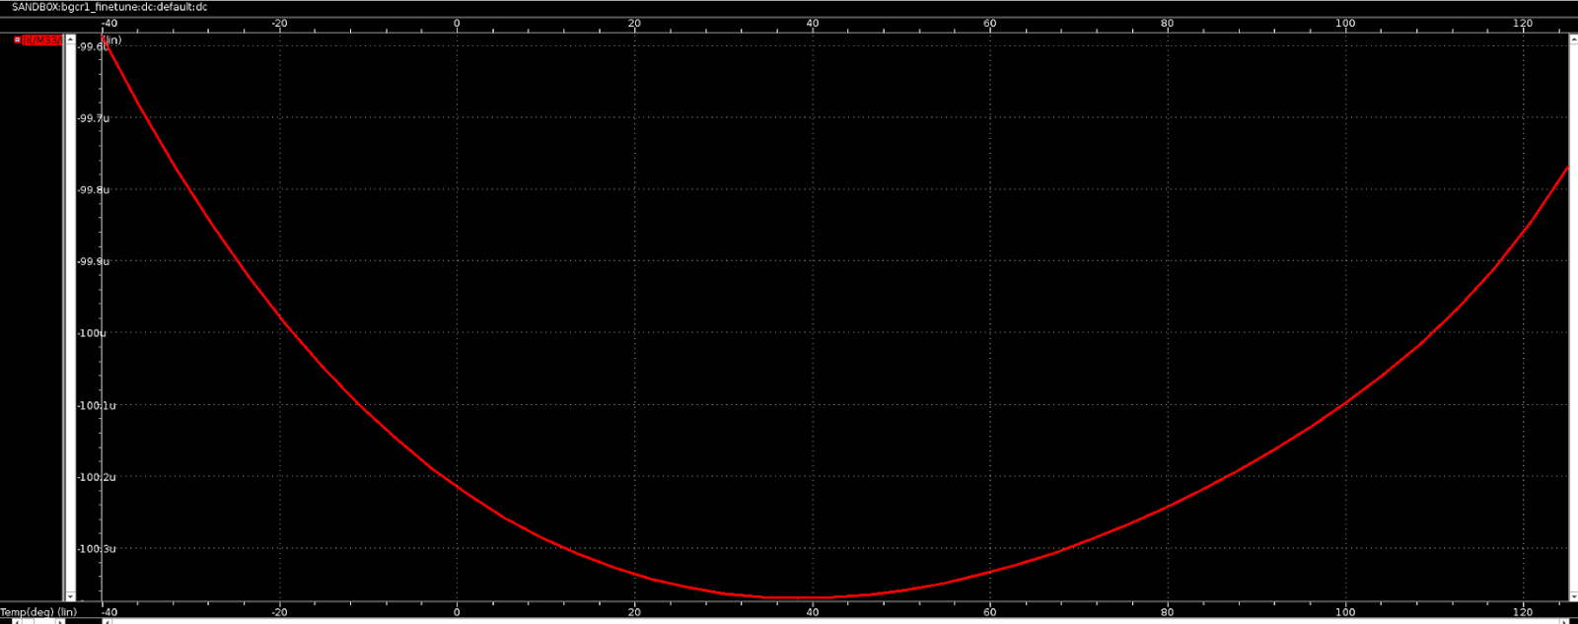
Output current sweep with temperature

Slide 15
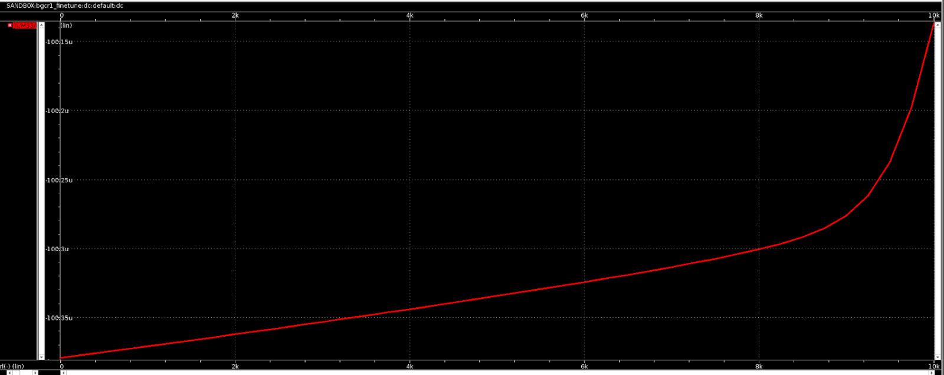
Output current sweep with temperature
Variation from 100.4 $μA$ to 100.15 $μA$ (0.25 % variation < 2% allowed variation)

Slide 16
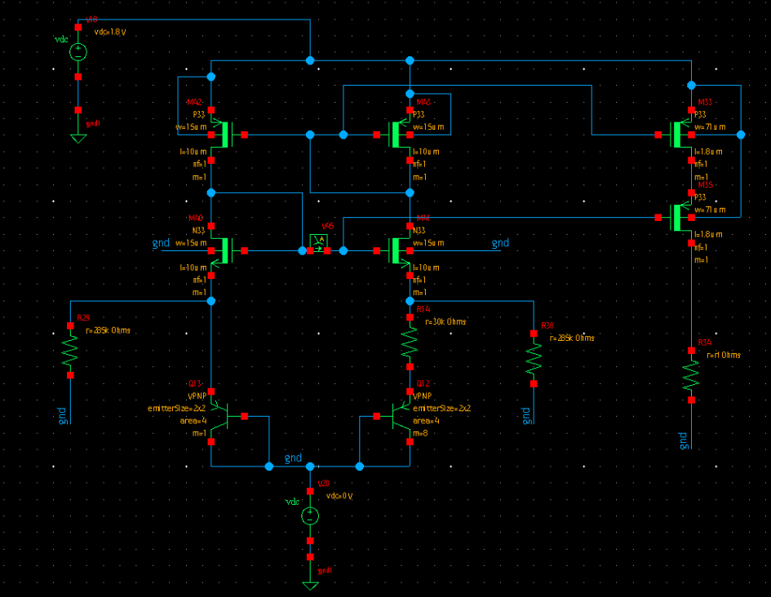
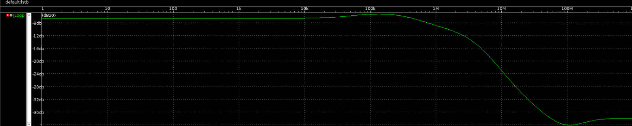
Stability Verification
A stb analysis was run using irpb method available in primewave, and the loop gain’s magnitude was found to be <1 for all frequencies, ensuring stable operation.

Slide 17
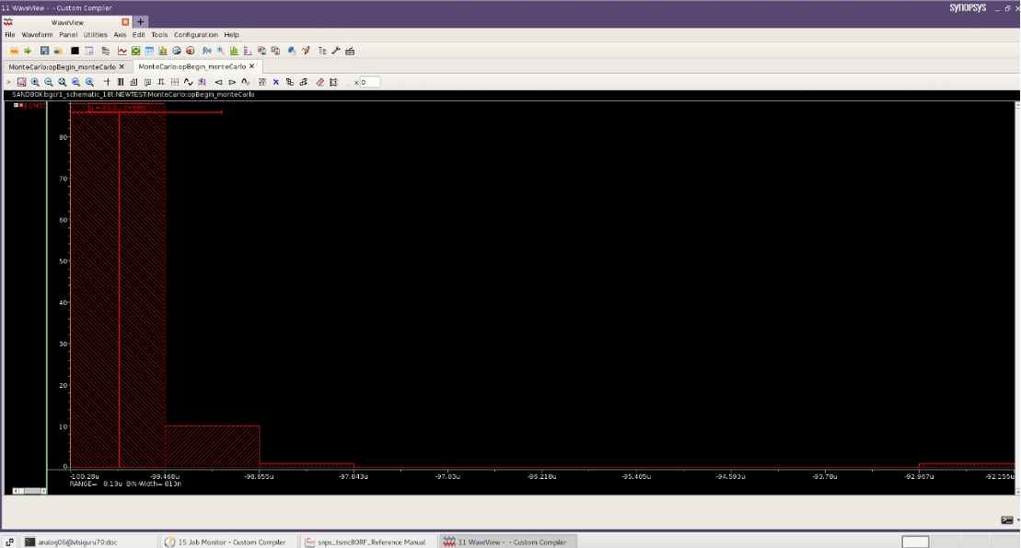
Monte Carlo Simulation
At 25 degrees, we got variance of 880 $nA$ and mean of 99.9 $μA$

Slide 18
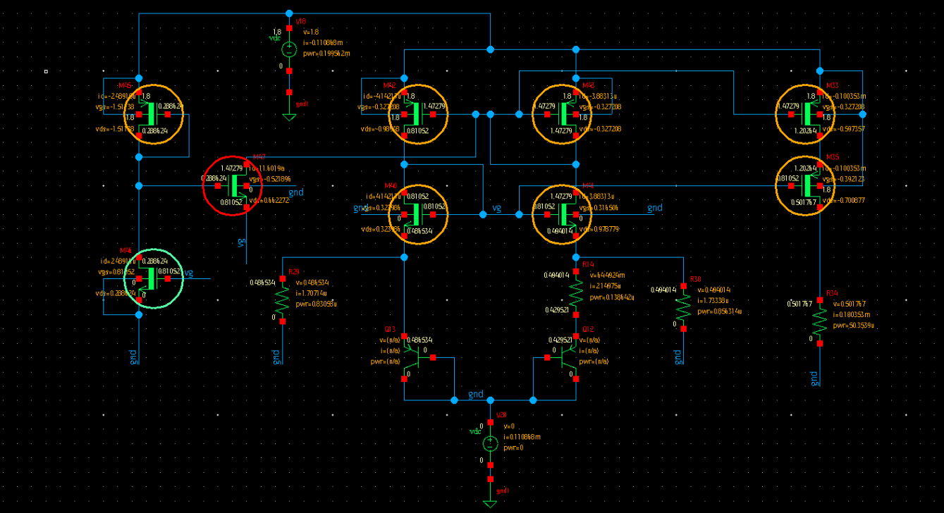
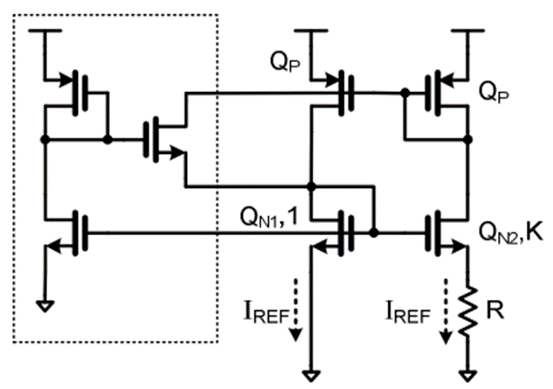
Startup Circuit

Slide 19
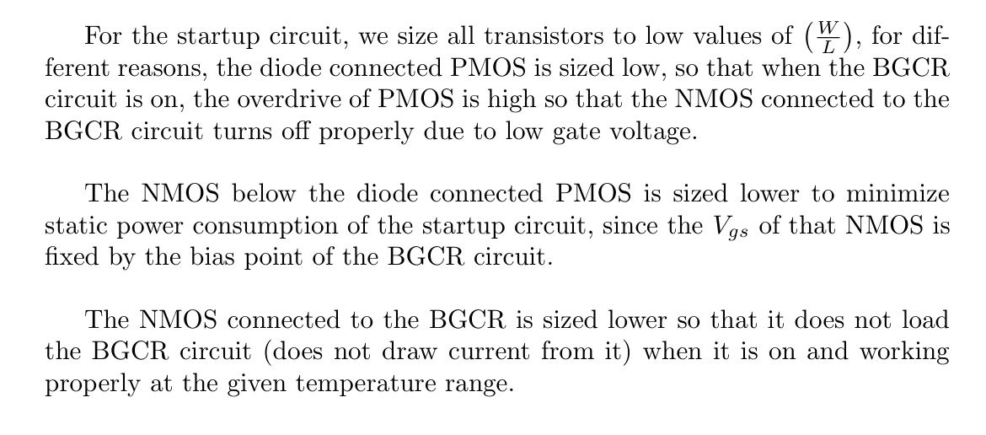

Slide 20
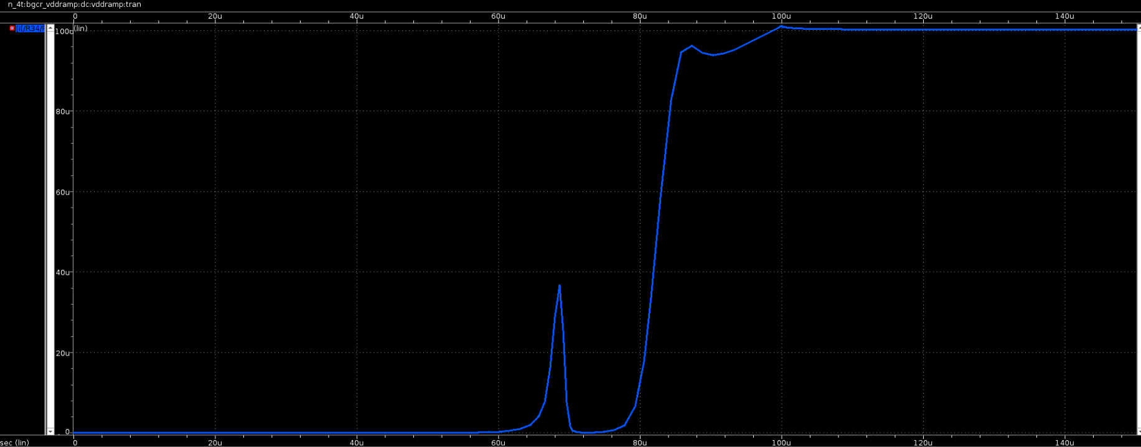
Startup Transients on a Vdd ramp of $1.8V/50μs$

Slide 21
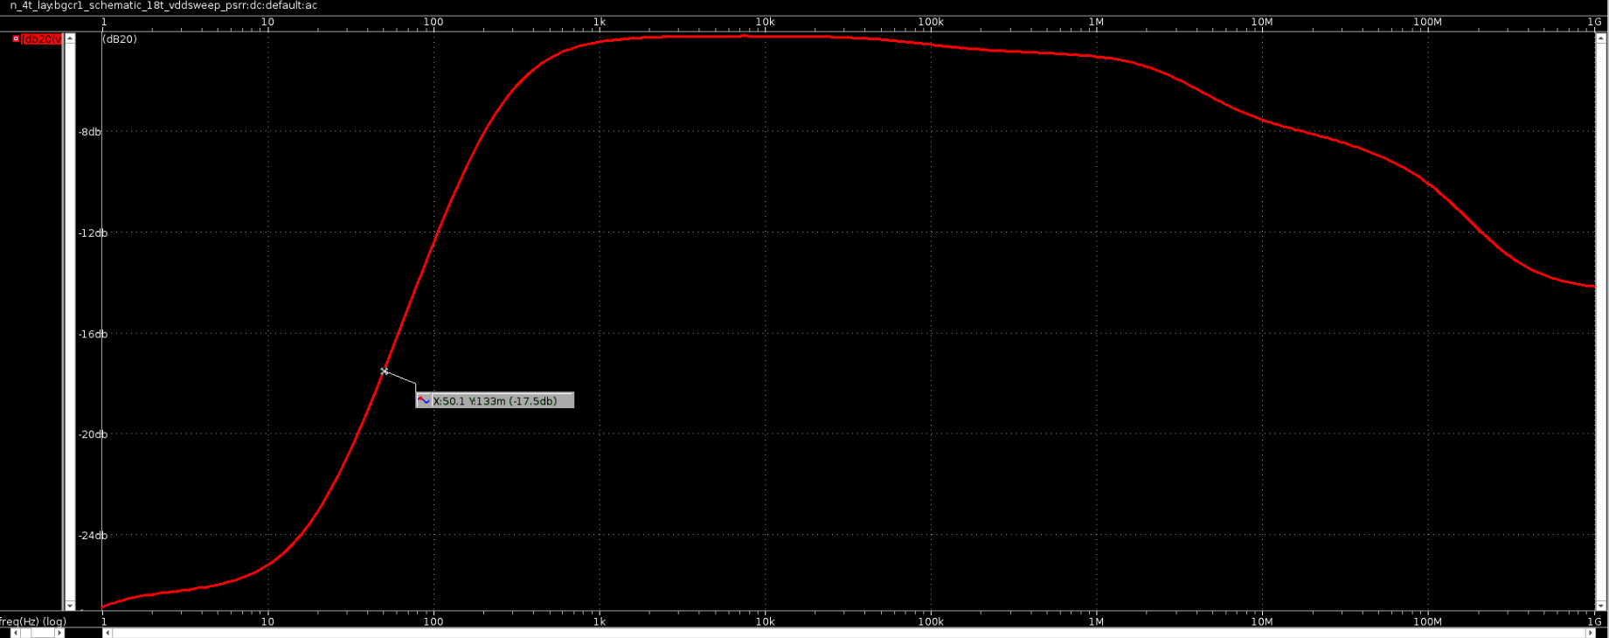
PSRR (17.5 $dB$ to reject 50 $Hz$ supply noise)

Slide 22
LAYOUT

Slide 23

The VPNP 1:8 Layout

Slide 24
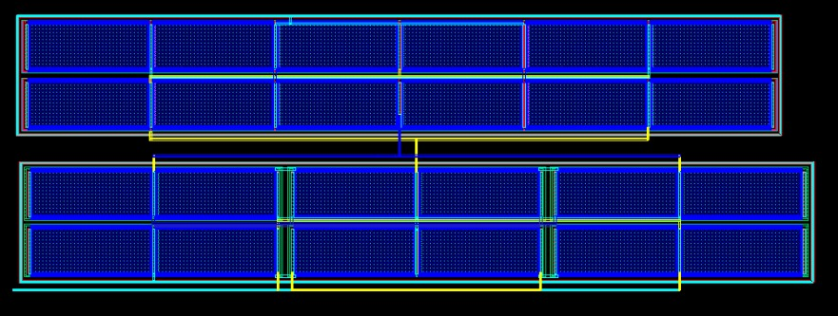
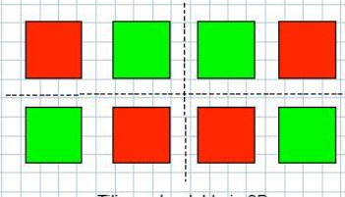
Beta Multiplier

Slide 25
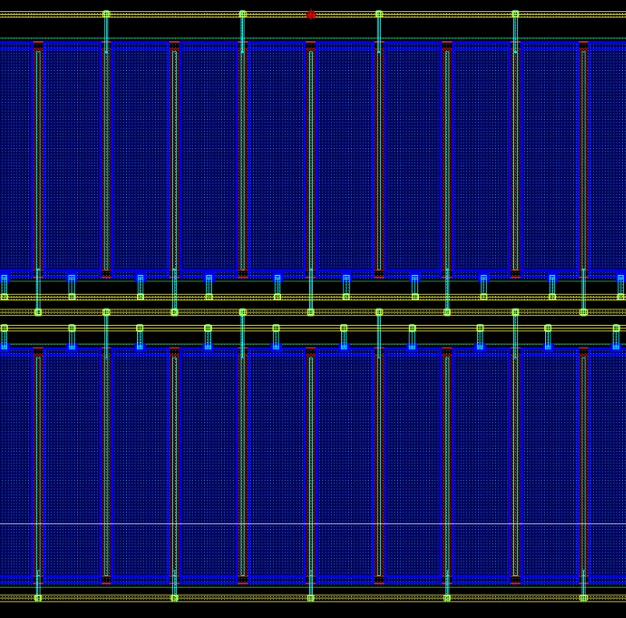
PMOS current mirror (Output Mirror)

Slide 26
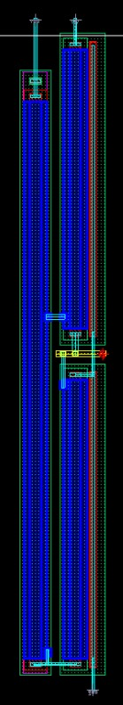
Startup

Slide 27
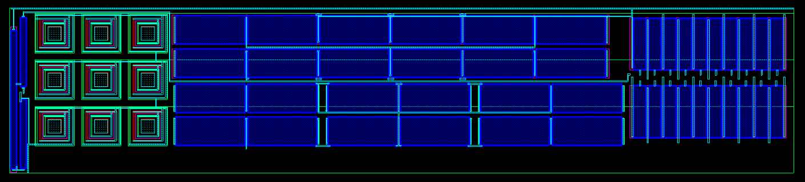
Combined Layout and its PEX (StarRC view)

Slide 28
Smartwatches: The Ideal Use Case for BGCR
Reliable Biasing : Delivers stable current for sensors, RF transceivers, analog front ends, ADCs, and filters, enabling accurate sensing and seamless BLE communication.
Wide Temperature Resilience : Operates flawlessly across -40°C to 125°C, ensuring reliable performance in diverse environments, from extreme outdoor conditions to everyday use.
Excellent Load Regulation : Maintains ±0.2% output stability to support varying loads, such as displays, sensors, and communication modules.

Slide 29
Low Power Consumption : Consumes only 20 µW, optimizing battery life for extended use in power-constrained devices like smartwatches.
RF Stability : Ensures frequency Stability of RF oscillators, enabling consistent and reliable BLE connectivity.
LDO Integration : Acts as a dependable bias source for LDO regulators, powering multiple smartwatch subsystems efficiently.

Slide 30
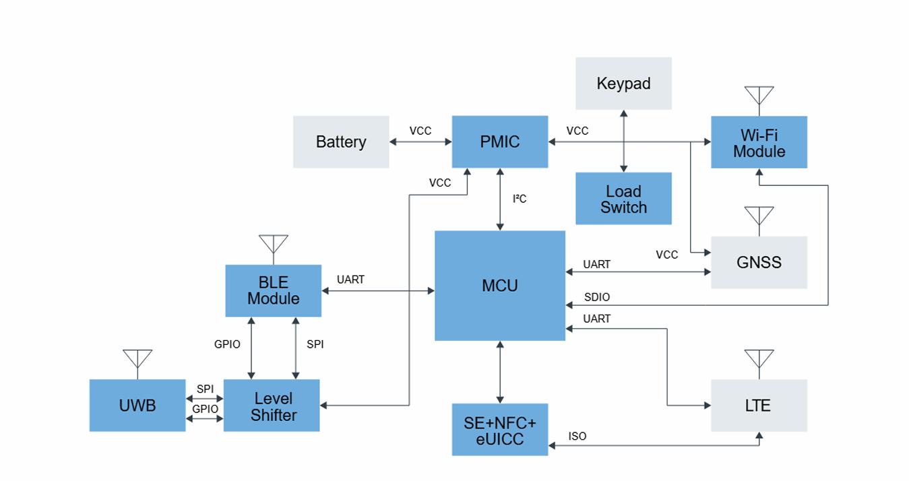
Power Management IC (PMIC) uses the
current reference to bias the MCU and Wi-fi Module

Slide 31

THANK YOU
FETManiacs

